Slide 1
Guessing Game Warm Up

Slide 2
Warm-up:
1. Who is he?
Answer: 陳時中
2. What subject is it?
Answer: PE

Slide 3
Warm-up:
3. What movie is it?
Answer: Toy Story
4. Where are you from?
Answer: Taiwan

Slide 4
PLACES:
1. Where are you?
ilorgnomvi
Answer: living room
2. Where are you?
moorhtab
Answer: bathroom

Slide 5
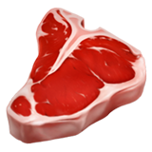
PLACES:
3. Where are you?
tenhick
Answer: kitchen
4. Where are you?
grindmooni
Answer: dining room

Slide 6
PLACES:
5. Where are you?
broomed
Answer: bedroom
6. Where are you?
dary
Answer: yard

Slide 7
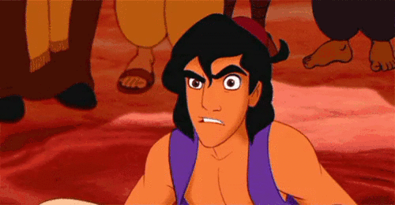
Guessing Game Warm Up
Part 2

Slide 8
1. Activity:
What did you do last week?
Answer: flash mob
快閃

Slide 9
2. People:
Who is she?
Answer: Abby Wu
302吳韶雯老師

Slide 10
3. Game:
What’s the name of this game?
Answer: Werewolf
(狼人殺)

Slide 11
4. Place:
Where is the city?
Answer: France Paris
法國巴黎

Slide 12
5. News:
What happened?
Answer: Taiwan is rejected by WHO. 台灣被拒絕加入世界衛生組織

Slide 13
Homework this week
聽: CD2第2-6首。
說&讀:聽CD時跟著大聲唸。完成3遍
請家長在課本P48簽名，可換印章。
寫:英語練習簿單字
+兩題emoji猜謎創作

Slide 14
Your turn! 至少出兩題:
Place (真實存在的地點)- country, city, mall, scenic spot, any public place, parts of a school, rooms of a house… 都可以!
 不是哇塞秘境、霍格華茲學院、亞特蘭提斯王國… 之類的傳說地點，或只有在小說、電影、漫畫… 裡出現的地方~
2. 食物、動物、人物、交通工具、童話故事名稱 、歷史事件、時事新聞、動漫角色、電影 片名… 都可以!
 也可以加上scrambled 的字母 但不要寫出答案

Slide 15
Warm-up:
1. Who is he?
Answer: 陳時中
2. What subject is it?
Answer: PE

Slide 16
Warm-up:
3. What movie is it?
Answer: Toy Story
4. Where are you from?
Answer: Taiwan

Slide 17
PLACES:
1. Where are you?
ilorgnomvi
Answer: living room
2. Where are you?
moorhtab
Answer: bathroom

Slide 18
PLACES:
3. Where are you?
tenhick
Answer: kitchen
4. Where are you?
grindmooni
Answer: dining room

Slide 19
PLACES:
5. Where are you?
broomed
Answer: bedroom
6. Where are you?
dary
Answer: yard

Slide 20
a room with a bath
bathroom

Slide 21
a room with a bed
bedroom

Slide 22
a room where we can have dinner
dinner
dining
sounds alike
dining room

Slide 23
a room where we can live
living room

Slide 24
a room where we can cook
chicken
kitchen

Slide 25
a place where we play and plant
yard

Slide 27
Challenge Time!!!!!

Slide 28
Q1. Where in the house do you brush your teeth?

Slide 29
Q2. Where in the house do you cook food?

Slide 30
Q3. Where in the house do you sleep at night?

Slide 31
Q4. Where in the house do you eat dinner?

Slide 32
Q5. Where in the house do you sit with your family and watch TV?

Slide 33
Q6. Where do you see grass?

Slide 34
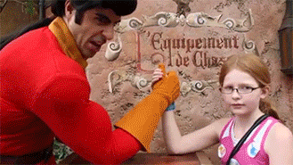
Harder Challenge!!!!!

Slide 35
Q7. Where are your books, toys and games?

Slide 36
Q8. Where are the dishes washed?

Slide 37
Q9. Where can you plant the flowers?

Slide 38
Q10. Where does your family relax together?

Slide 39
Q11. Where can you get wet inside your house?

Slide 40
Q12. Where is the largest table for eating?

Slide 41
Word Searching

Slide 42
am
I
is
He
She
It
We
You
are
They

Slide 43
Where are you?
I am
=I’m
I’m in the bathroom.

Slide 44
Where is Sheldon?
(Where’s)
He is
=He’s
He’s in the bedroom.

Slide 45
Where is Tiana?
(Where’s)
She is
=She’s
She’s in the kitchen.

Slide 46
Where are they?
They are
=They’re
They’re in the living room.

Slide 47
Challenge Time
Everyone in each group takes turns to pass out and speak aloud the answers.

Slide 48
Where are you?
I’m in the kitchen.

Slide 49
Where is she?
She’s in the bathroom.

Slide 50
Where is Justin Bieber?
He’s in the yard.

Slide 51
Where is Pikachu?
It’s in the bedroom.

Slide 52
Where are you ?
We’re in the dining room.

Slide 53
Where are Simpsons?
They’re in the living room.

